Slide 1
Car Data Analysis
Name : Sakshi Laxman Waghmare

Slide 2
Business Objectives
The objective of the project is to analyse a car dataset to gain insights into popular trends and identify key factors for launching promising car models. Extract actionable insights from the given data, addressing key areas such as categorizing cars based on market segmentation, conducting fuel efficiency analysis, comparing performance, studying weight distribution, assessing safety features, exploring user comfort, analysing alert systems, and conducting dimensional analysis.

Slide 3

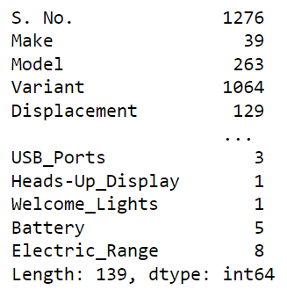
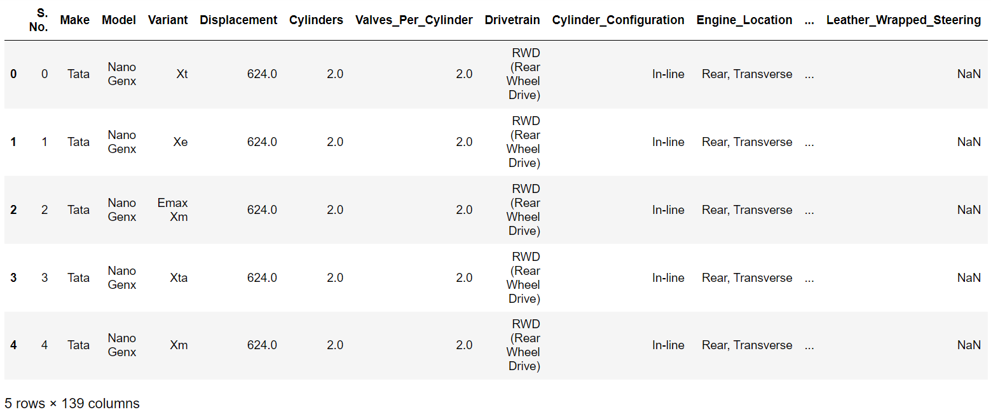
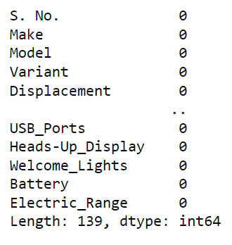
Data Understanding & Pre-processing
Number of rows and columns
Number of unique values in each column
Number of missing values in each column
First five rows
Note:
The dataset has been refined by employing appropriate measures to remove null values.

Slide 4
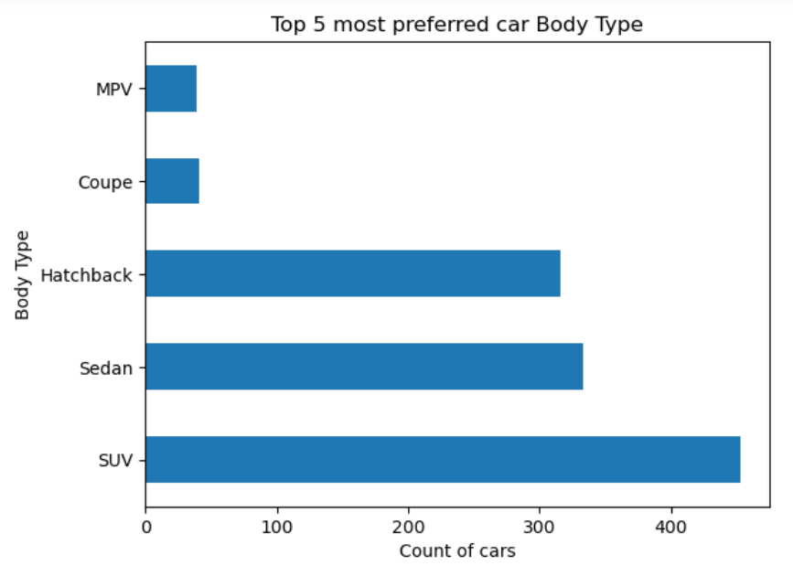
Market Segmentation Analysis Identify and categorize cars based on make, model, and body type to understand market trends and consumer preferences.
Interpretation:
The preferred car body types encompass SUVs, sedans, hatchbacks, coupes, and MPVs.

Slide 5
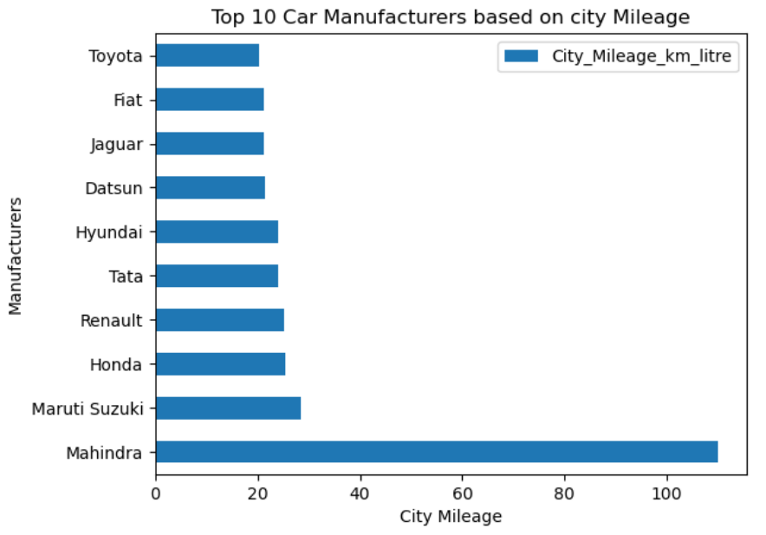
Fuel Efficiency Analysis Evaluate the fuel efficiency of different car models by analysing city and highway mileage, helping manufacturers focus on eco-friendly designs
Interpretation:
Mahindra stands out as a manufacturer, offering the highest city mileage compared to other manufacturers. Mahindra is an outlier in this aspect.

Slide 6
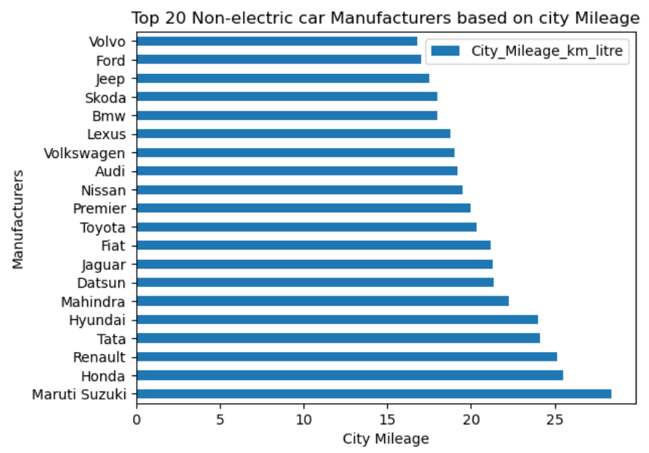
Fuel Efficiency Analysis Evaluate the fuel efficiency of different car models by analysing city and highway mileage, helping manufacturers focus on eco-friendly designs
Interpretation:
Maruti Suzuki, Honda, and Renault stand out in the non-electric car market by delivering vehicles with the highest city mileage, emphasizing their commitment to fuel efficiency and urban driving experience.

Slide 7
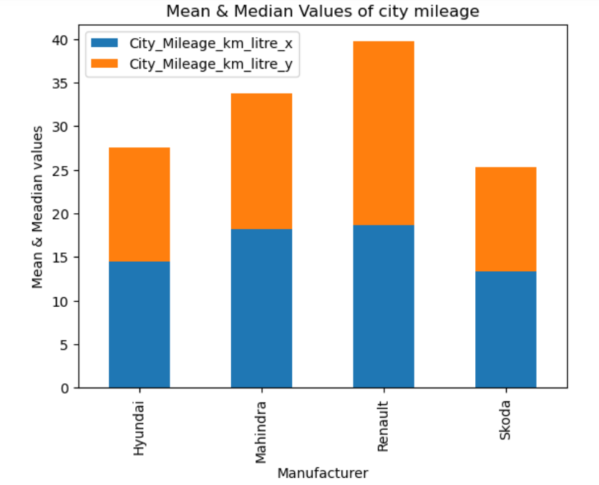
Fuel Efficiency Analysis Evaluate the fuel efficiency of different car models by analysing city and highway mileage, helping manufacturers focus on eco-friendly designs
Interpretation:
Renault boasts the distinction of having both the highest average and median city mileage.

Slide 8
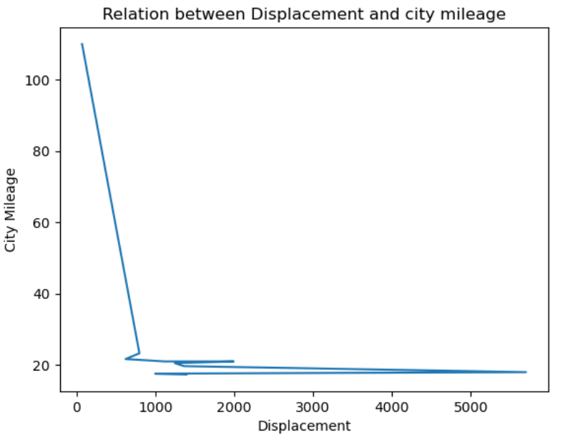
Fuel Efficiency Analysis Evaluate the fuel efficiency of different car models by analysing city and highway mileage, helping manufacturers focus on eco-friendly designs
Interpretation:
The graph shows that displacement and city mileage have a negative relation, meaning that as one increases, the other decreases. However, this relation is not consistent for all the cars, especially when the displacement is above 700 cc.

Slide 9

Part – 1 Market segmentation analysis
Conclusion:
Car preferences span SUVs, sedans, hatchbacks, coupes, and MPVs. Audi's Q8 and A8 L offer adaptable driving modes. Mahindra stands out with the highest city mileage, making it an outlier. Maruti Suzuki, Honda, and Renault lead in non-electric city mileage. Renault and Mahindra have the highest average city mileage. Renault excels in both average and median city mileage. Hyundai, Renault, and Mahindra lead in average highway mileage, while Skoda has the lowest median. Datsun and Bajaj are recognized for impressive highway fuel efficiency. Graphs for Hyundai, Tata, and BMW suggest skewed fuel economy, hinting at outliers. Renault stands out with the highest average city mileage among these manufacturers.

Slide 10
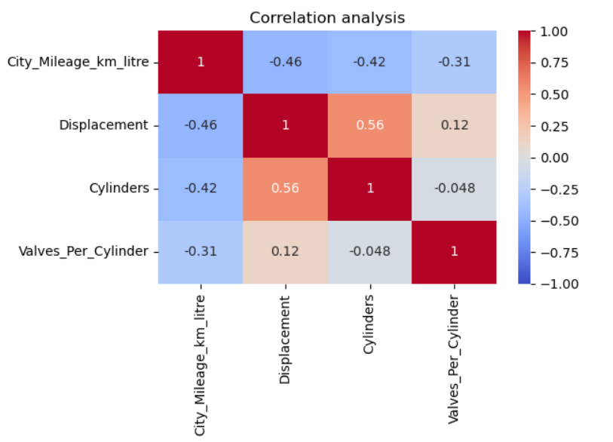
Performance comparison analysis
Interpretation:
As city mileage increases, there is a trend for engines to have lower displacement, fewer cylinders, and a reduced number of valves per cylinder.

Slide 11
Part – 2 Performance comparison analysis
Conclusion:
Bentley, Maruti Suzuki, Ferrari, Mahindra, Land Rover, Jaguar, Toyota, Audi, Aston Martin, and Lamborghini offer a diverse range of cars with varying displacements. A trend is observed, as city mileage increases, engines tend to have lower displacement, fewer cylinders, and fewer valves per cylinder. Datsun, Mitsubishi, Jeep, Renault, and Mini are known for producing cars with excellent capabilities for carrying baggage and weight.

Slide 12
Part – 3 Safety feature assessment
Conclusion:
Maruti Suzuki leads in safety standards, followed by Hyundai. Mahindra excels in family-friendly comfort, with Maruti Suzuki in second place. Maruti Suzuki offers the highest number of cars with alert systems, followed by Hyundai, Mahindra, and Tata. Tata specializes in tall cars, Maruti Suzuki in long cars, and Bentley in wide cars, showcasing diverse design philosophies.

Slide 13
Business Conclusion:
The automotive landscape presents a diverse array of preferences and performances across different car manufacturers. Maruti Suzuki consistently stands out in safety standards and alert system provision, emphasizing a commitment to driver and passenger well-being. Mahindra, on the other hand, excels in delivering vehicles with high city mileage and family-friendly comfort, making it a notable choice for urban commuting and family-oriented driving.
Renault emerges as a key player with the highest average city mileage, showcasing a focus on fuel efficiency. The preprocessing of 'Kerb Weight,' 'Power,' and 'Torque' columns reveals a trend among manufacturers such as Bentley, Maruti Suzuki, Ferrari, Mahindra, Land Rover, Jaguar, Toyota, Audi, Aston Martin, and Lamborghini, where higher city mileage correlates with lower engine displacement, fewer cylinders, and fewer valves per cylinder.

Slide 14


